Slide 1

CoronaOS and Interactive
By: Ege AYDEMİR and Aykan ÖRSÇELİK

Slide 2
Problems we aim to solve
With these 2 apps we wanted to make sure businesses are able to obey social distacing rules with ease.
We also wanted local businesses to stay in business during these difficult times.
We wanted to make sure everyone was psychologicaly stable while everyone was at home. We worked with a psychologist to create the questions
We also have informative videos on how to maintain a stable psychology during self isolation.

Slide 3
CoronaOS
Is for business owners who want to inspect their employees during Covid-19.
You can assign all your shops and employees in one place. Then the system generates a Schedule for all your employees to make sure everyone works at different times of the day. This prevents people from breaking social distancing rules

Slide 4
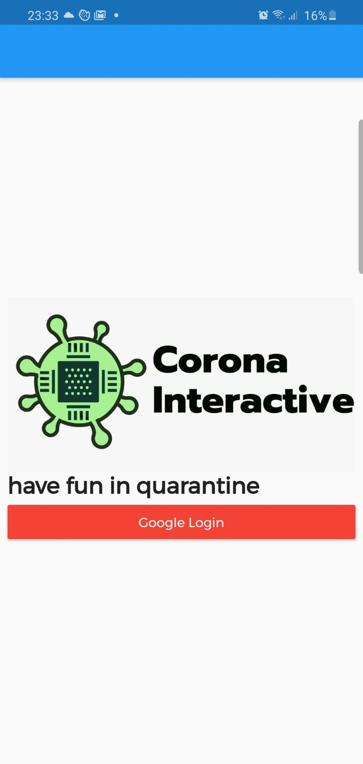
This is the login screen for CoronaOS

Slide 5
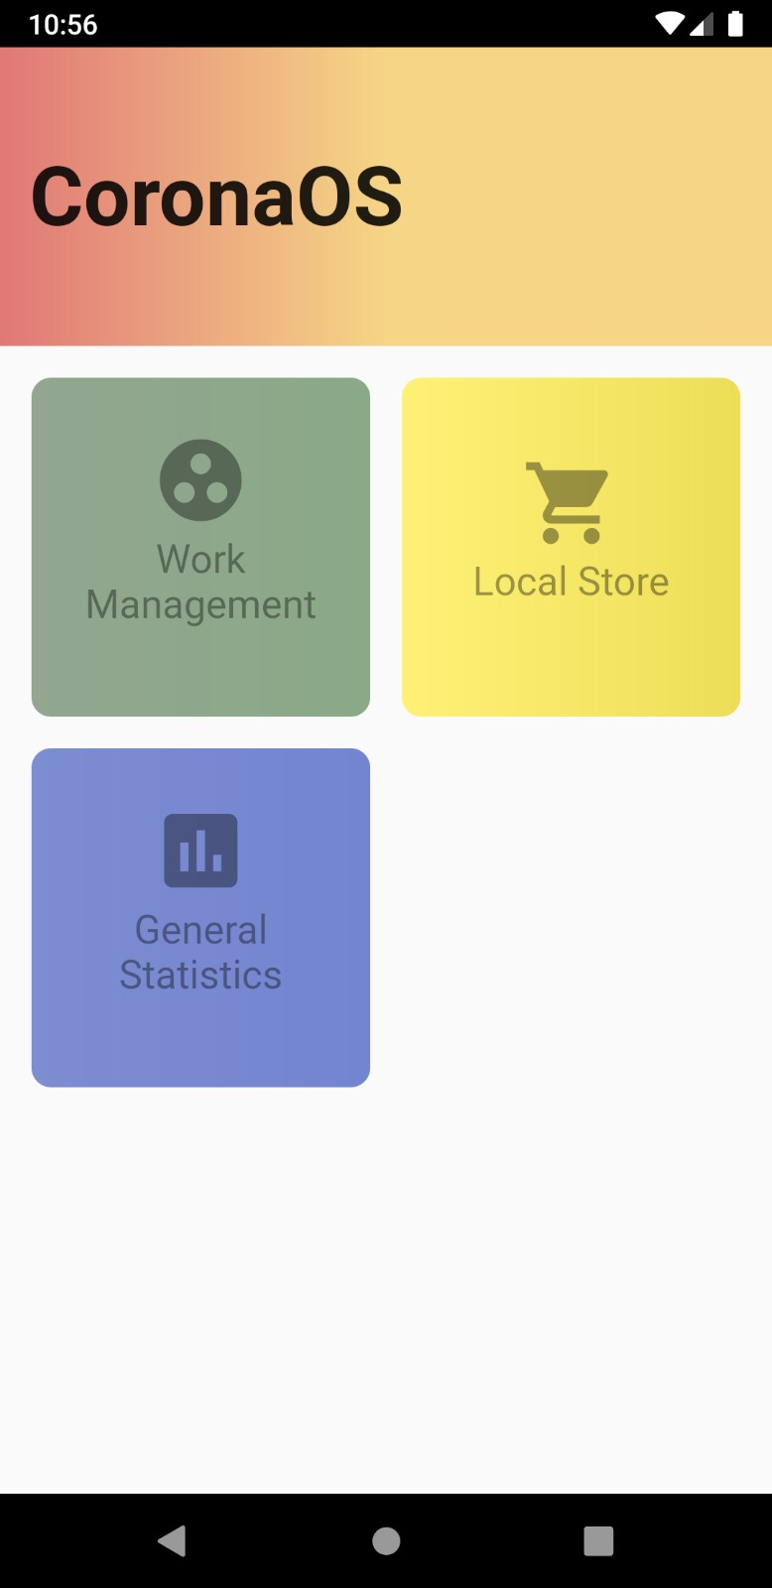
These are the main tabs. In work management you can add your workspaces and employees for each workspace.
Note: In the general statistics we were aiming to Show the overall mental situation of the workers with the help of the surveys but we werent able to finish it on time.

Slide 6
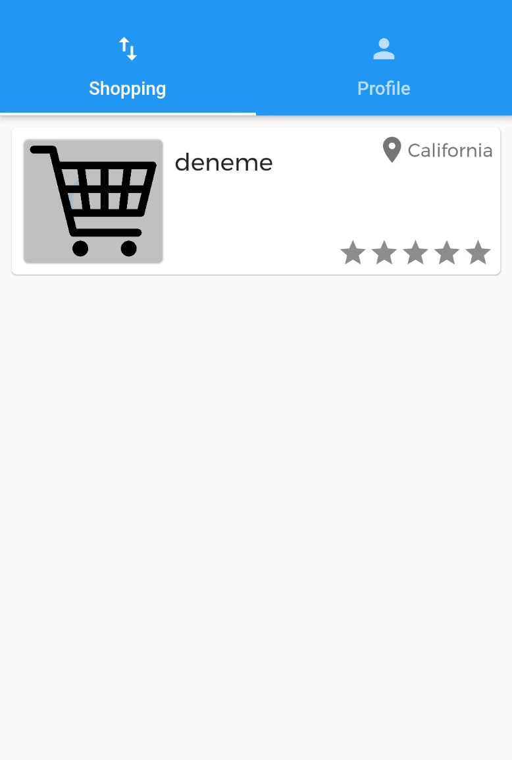
This is where you add your shop and employees.

Slide 7
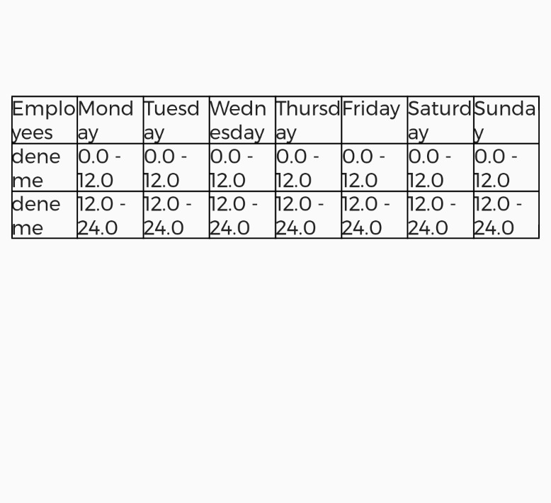
This an example schedule of what gets sent to the employees (CoronaInteractive) once the manager enters the employees.

Slide 8
The local store tabs is where the manager would see the orders from customers since we have this app as an apk we can’t have anyone register their products. Even though we have the tab and code.

Slide 9
CoronaInteractive
CoronaInteractive is an application for everyone
You can take quizes which we designed with a psycologist and receive feedback accordingly.
You can watch informative videos about Covid-19
You can shop from shops nearby which have been added to CoronaOS (work in progress).
You can also see your work Schedule once your boss finishes setting up the shop.

Slide 10
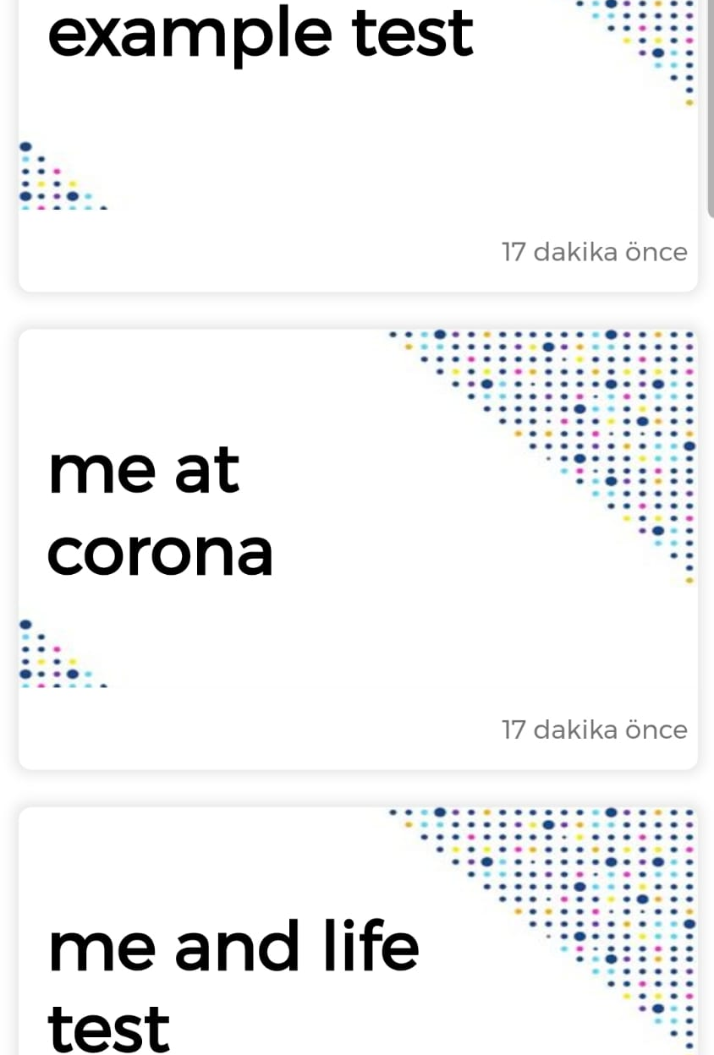
Tests you can take

Slide 11
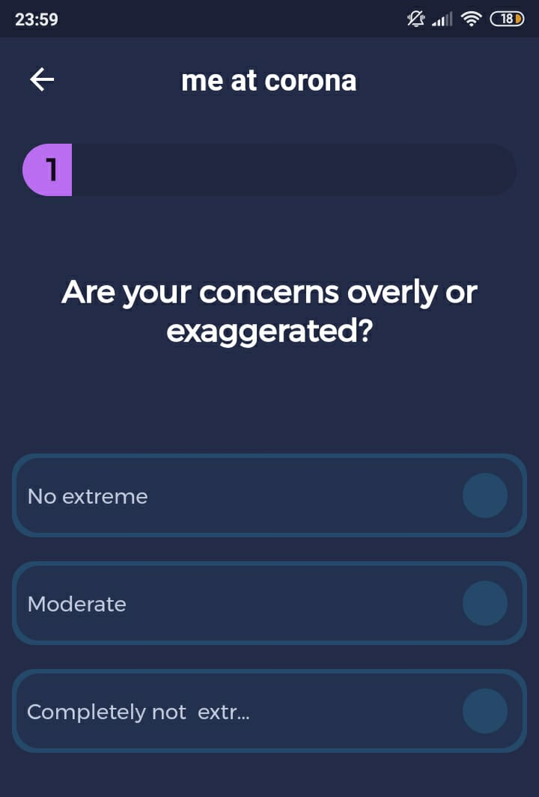
What the questions look like

Slide 12
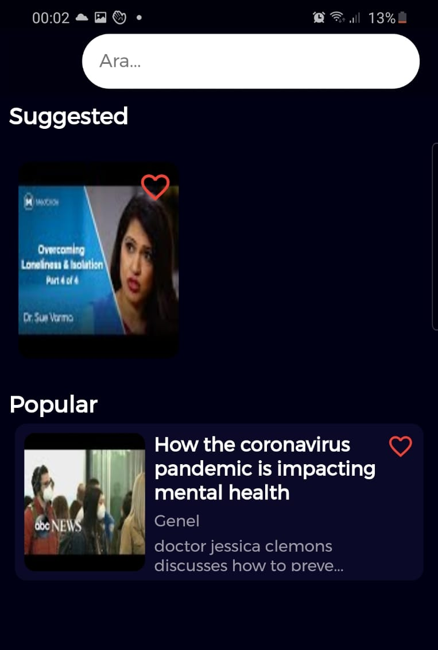
Here you can watch the videos

Slide 13
Disclaimer and problems
Unfortunately, with limited time we were only able to upload 2 of the 10 videos we selected.
We also had trouble uploading the questions we prepared with the psychologist but we will upload the questions we prepared as a Word file if anyone wants to look at them.
We are Turkish and some things like the enter tabs are unfortunately in Turkish. We are sorry for the incovienience

Slide 14

Referances
https://drive.google.com/file/d/1Aat2FMgmx2ZUfL7_HCxzwvdUFHRx2bBR/view?usp=drivesdk

Slide 15
Thank you for listening

